Slide 1
CNN

Slide 2
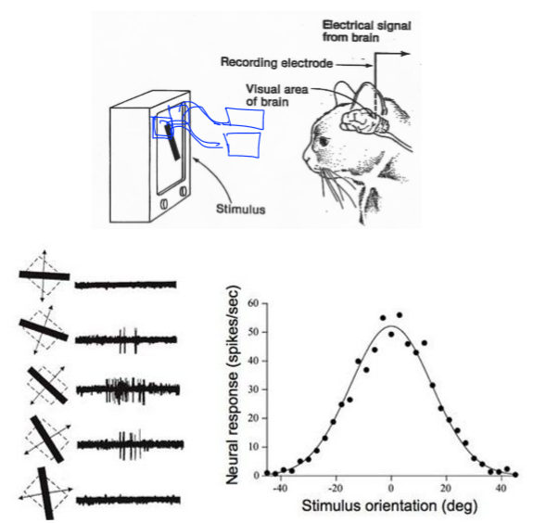
Cnn 배경

Slide 3
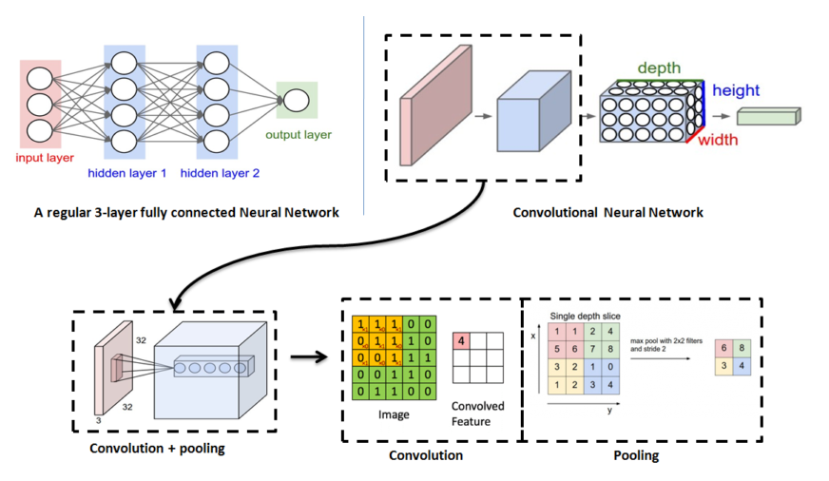
Use Why

Slide 4
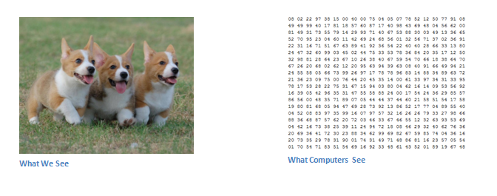
Image-Pixel

Slide 5
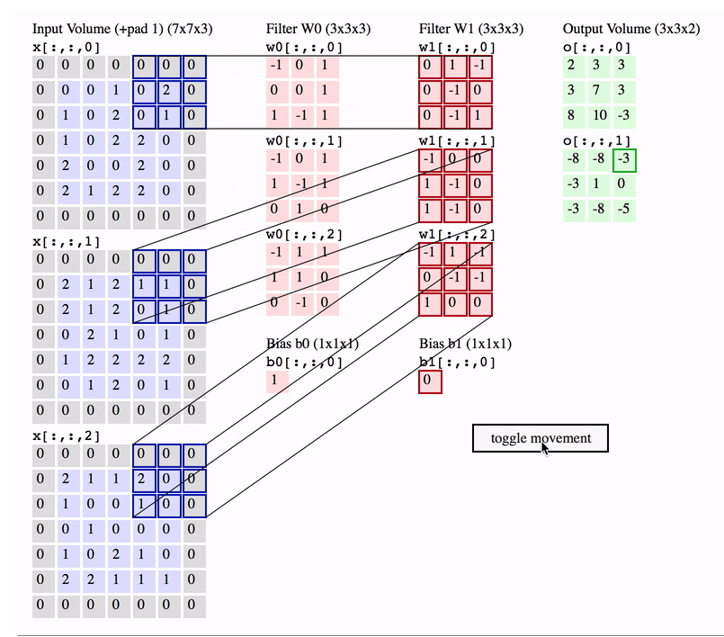
Convolution
Operation

Slide 6
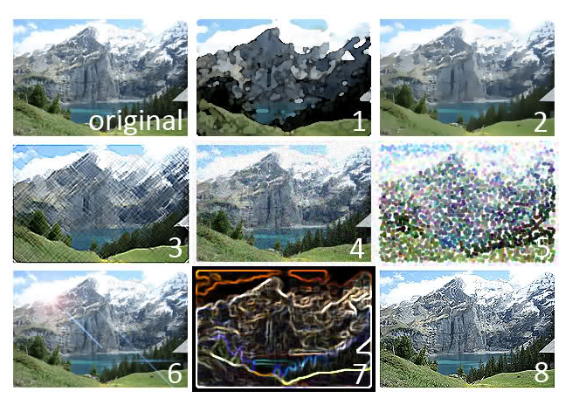
Filters

Slide 7
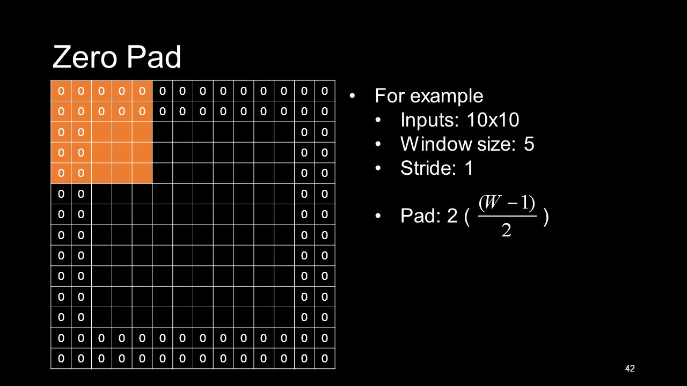

Slide 8
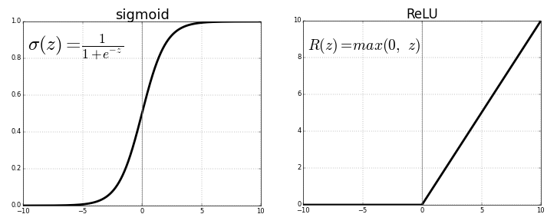
Activation Function

Slide 9
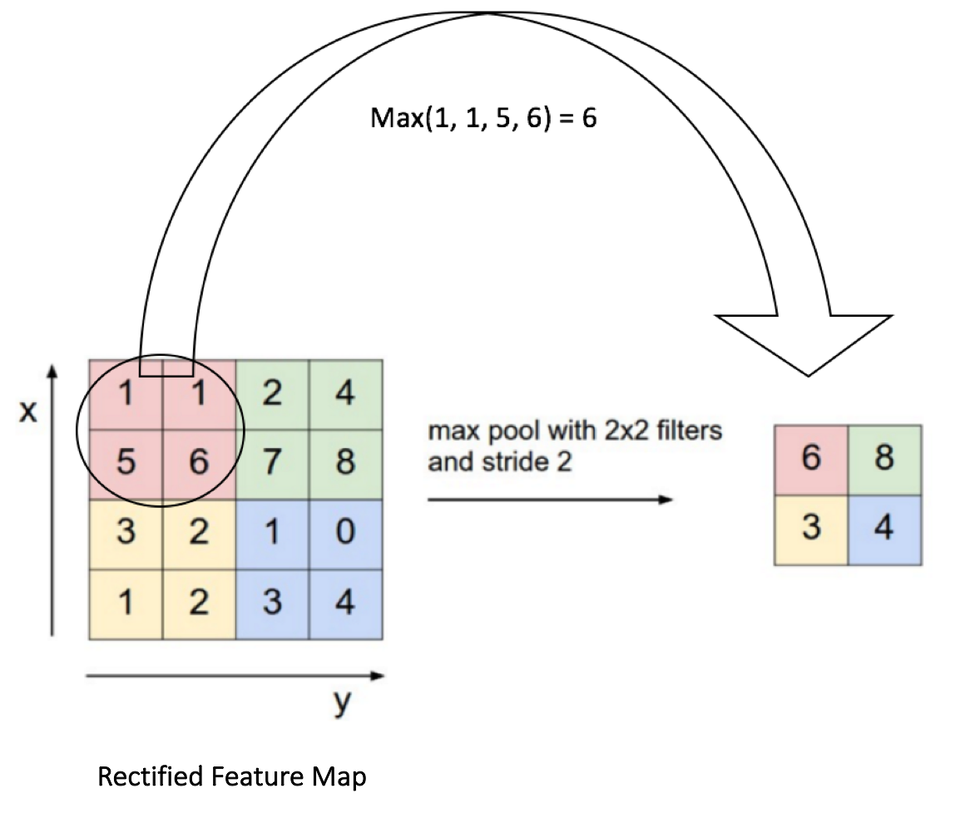
Pooling (SubSampling)

Slide 10
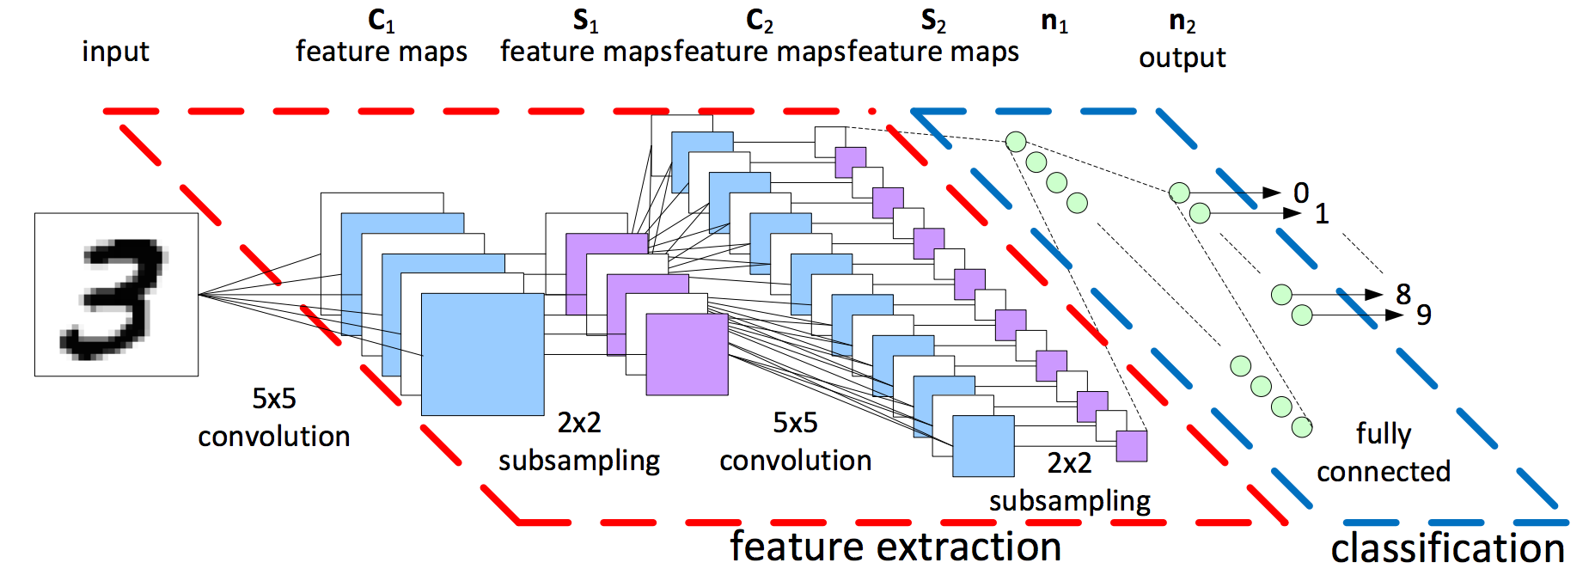
Overal CNN

Slide 11
감사합니다

